Slide 1
Vigenere Cipher and Cryptanalysis

Slide 2
Recap: Caesar Cipher
Substitution of letters with a single shift.
Bad because there are only 26 letters, which gives 25 possible shifts.
Easily broken by Brute Forcing.

Slide 3
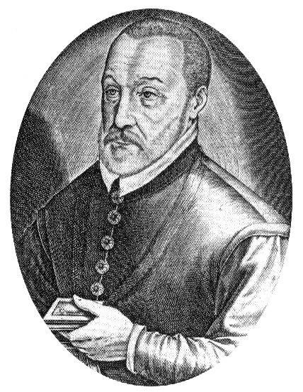
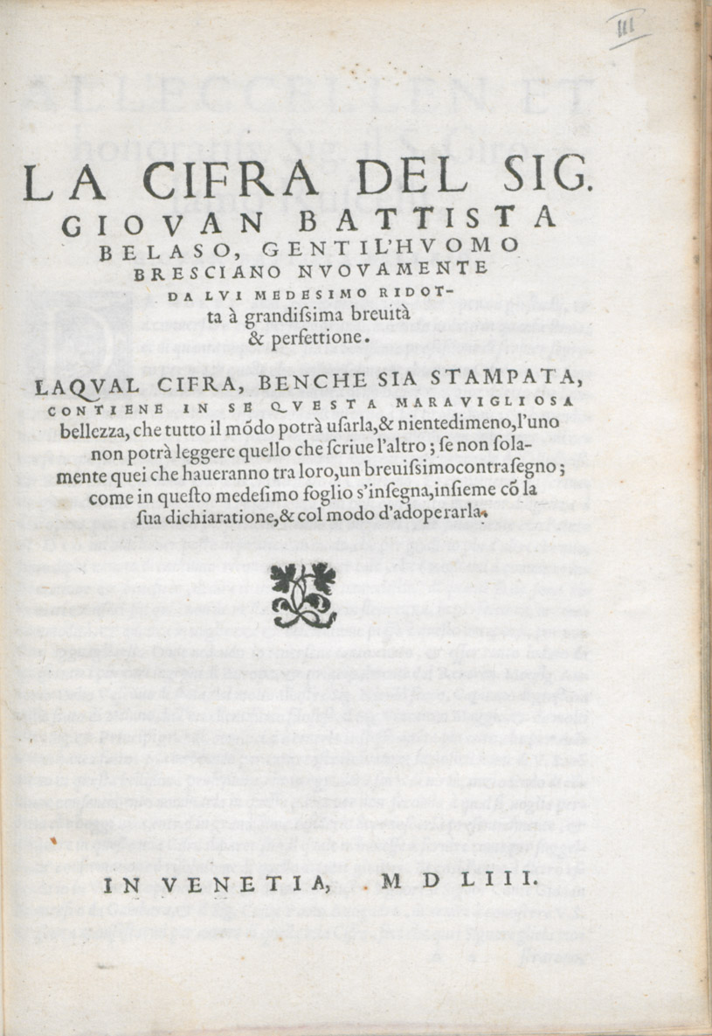
Vigenere Cipher
Named after Blaise de Vigenère, a French diplomat, cryptographer, translator and alchemist. However, Giovan Battista Bellaso, an Italian cryptologist, invented it in 1553 and misunderstood to be invited by Vigenère in the 19th century.
Notes:
Pic credits: https://en.wikipedia.org/wiki/Vigen%C3%A8re_cipher#/media/File:Vigenere.jpg

Slide 4

What is the Vigenere Cipher?
It is based on letter substitution just like Caesar cipher. BUT, with a twist!

Slide 5
Is the Vigenere Cipher Secure?
The Vigenere Cipher was unbreakable for 300 years after its creation. Coined the nickname “The Indecipherable Cipher”.
The normal vigenere system is still a substitution of letters, but, you use a password(THE TWIST!). Guessing the password length could be easily done by overlapping the text to find repeating patterns. (COMING SOON!)
But,
There are some schemes that can be tricky to solve...

Slide 6
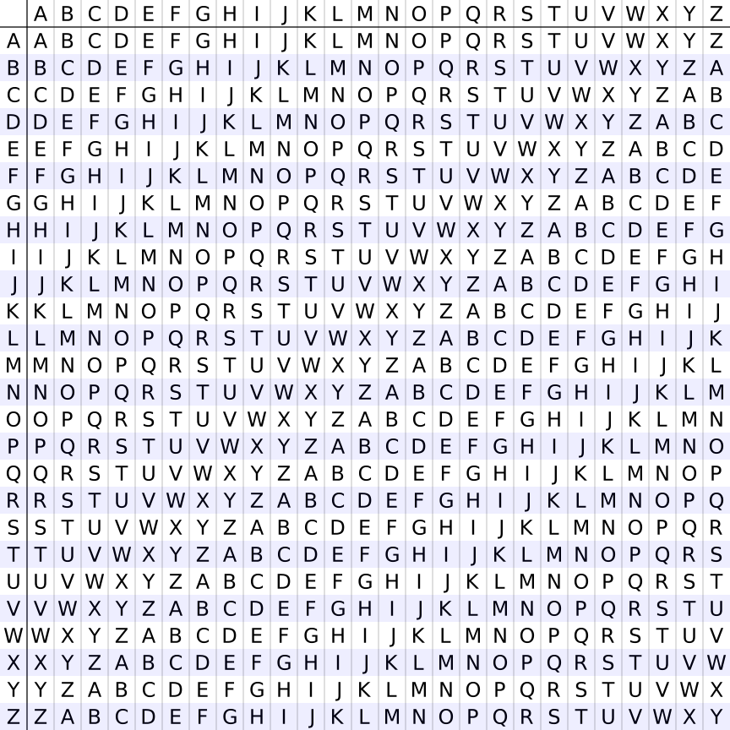
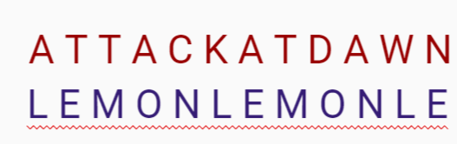
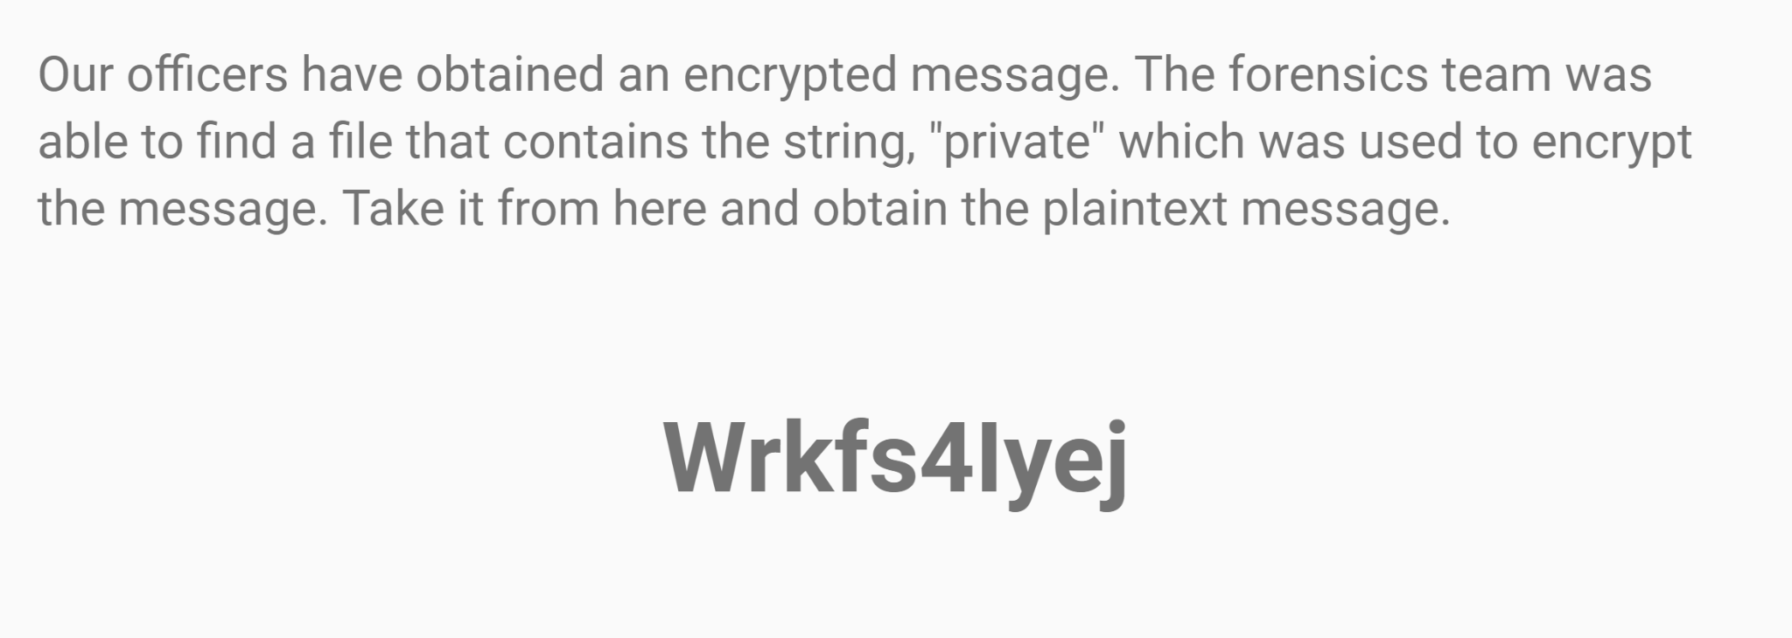
What is Vigenere (cont.) ?
Plaintext
So now, all we need to do is share a password. Let’s say the password is ‘Lemon’.
The letters on the left: Form the password.
The Letters on top: Form the plaintext letters you want to encrypt.
Key

Slide 7
Enciphering Using Vigenere
While Caesar Cipher used a single shift for its letters, vigenere had the brilliant idea of changing the shift as the letters progressed.
Example:
Plaintext: A T T A C K A T D A W N Key: L E M O N L E M O N L E Your shift changes with the word LEMON
Ciphertext: L X F O P V E F R N H R

Slide 8
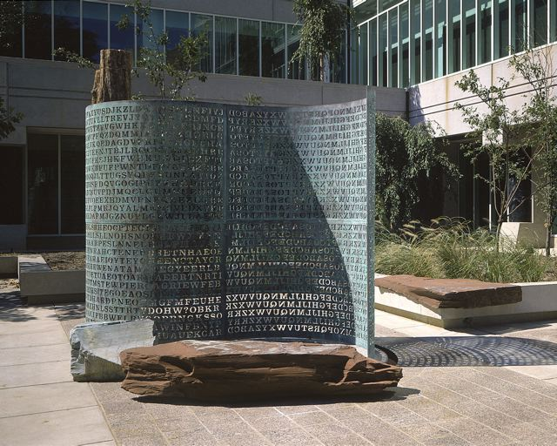
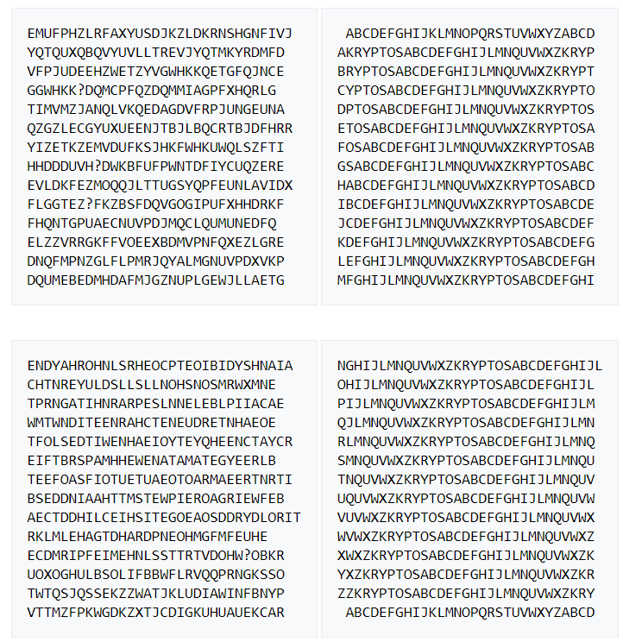
KRYPTOS
I give you one of the most famous unsolved puzzles in the world!
Kryptos, a sculpture created by artist and professional codebreaker Jim Sanborn, stands in the courtyard of the CIA headquarters at Langley.
PARTS 1,2 and 3 have been solved.
PART 4 remains publicly unsolved till this day! (31 years!!)
Can you solve it?
Notes:
Pic Credits: https://en.wikipedia.org/wiki/Kryptos#/media/File:Kryptos_sculptor.jpg
Pink Panther: Deviant Art

Slide 9
Cryptanalysis
How to crack a Vigenere Cipher without the password

Slide 10

Steps of Cryptanalysis
Determine key length
Break up Ciphertext
Use frequency analysis on each part

Slide 11
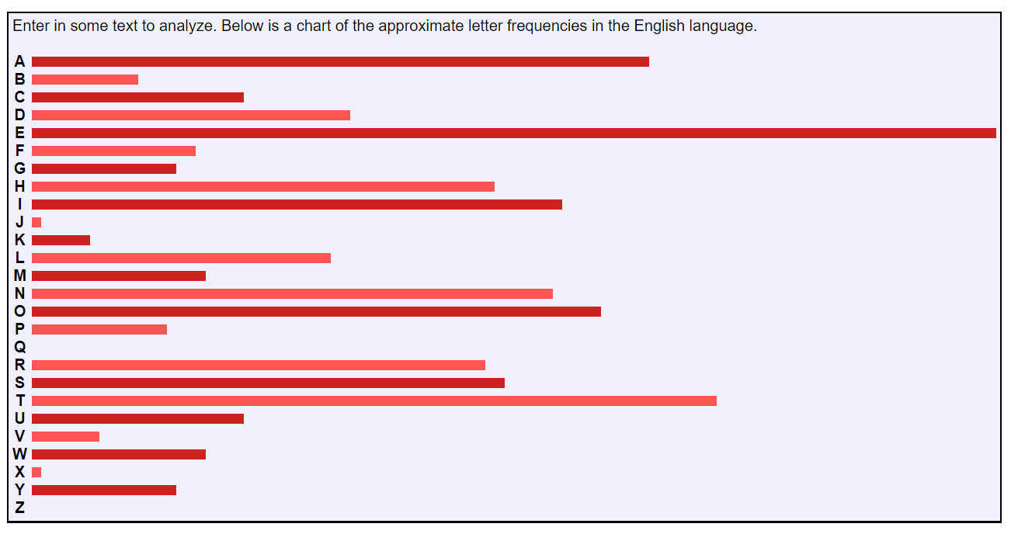
What is Frequency Analysis?
It is simply calculating how many times a letter is in a given ciphertext and comparing it with its given occurrence in the English Language.
**We are assuming the plaintext is randomly chosen English, not a random string.

Slide 12
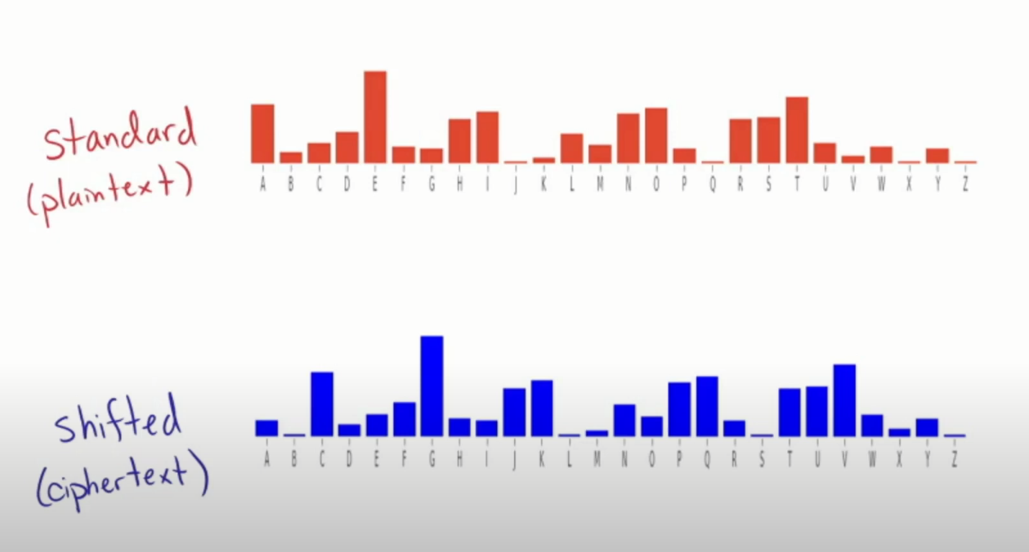
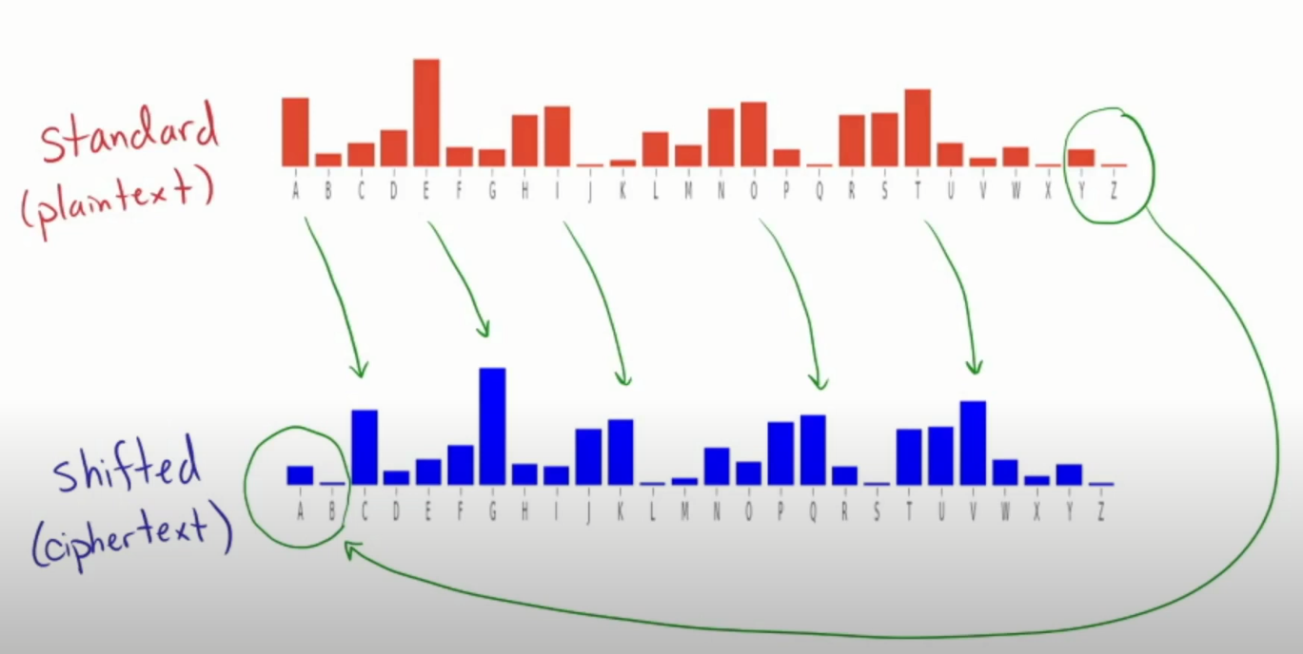
Frequency Analysis in Caesar Cipher
Notes:
https://www.youtube.com/watch?v=QgHnr8-h0xI

Slide 13
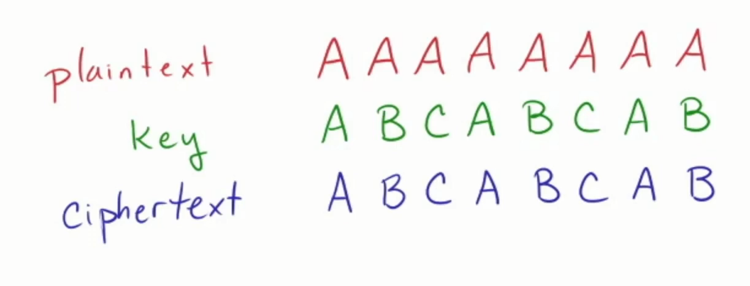
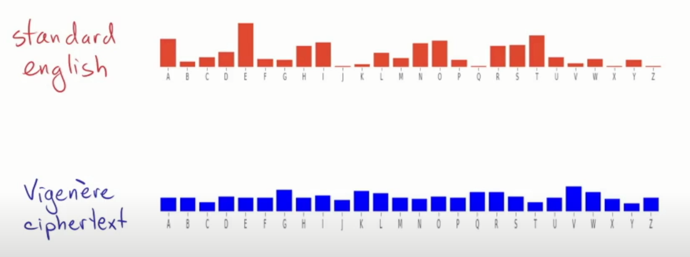
This is a bit tougher with the Vigenere Cipher
Shifts vary!
Notes:
https://www.youtube.com/watch?v=QgHnr8-h0xI

Slide 14
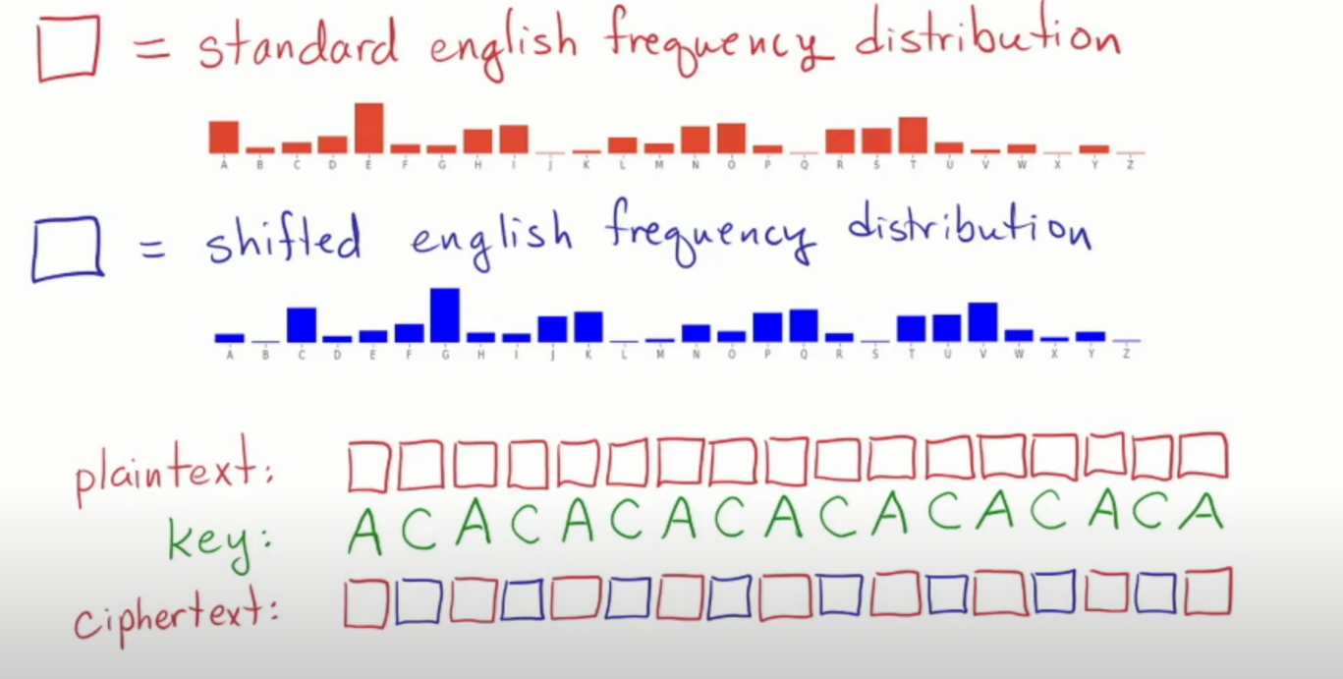
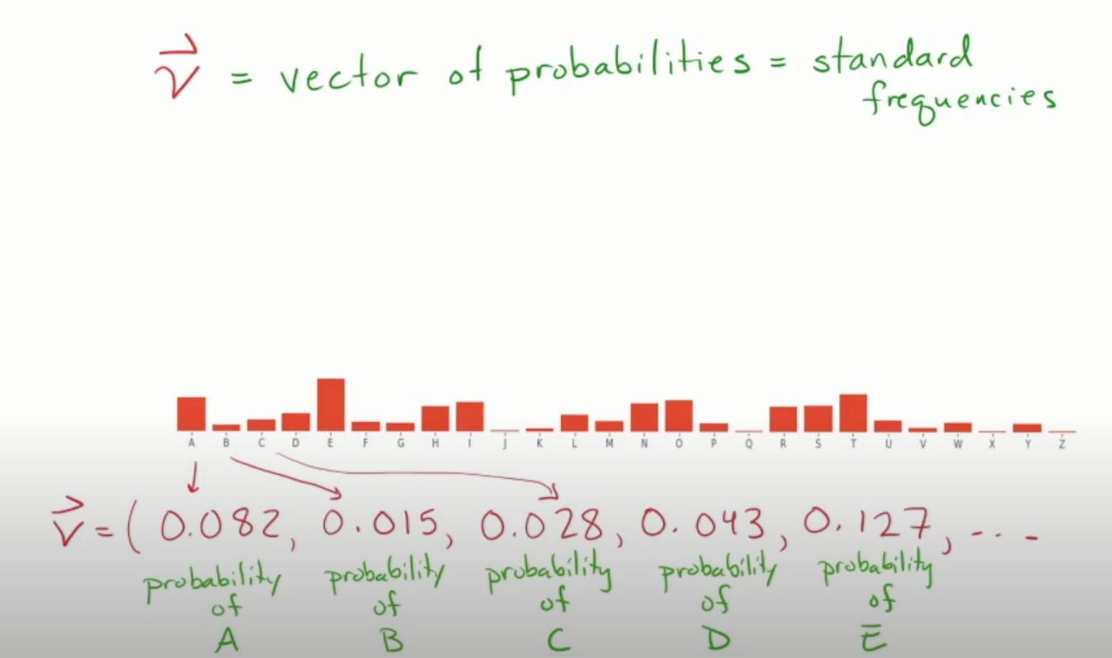
Where do we go from here?
Guess work and math!

Slide 15
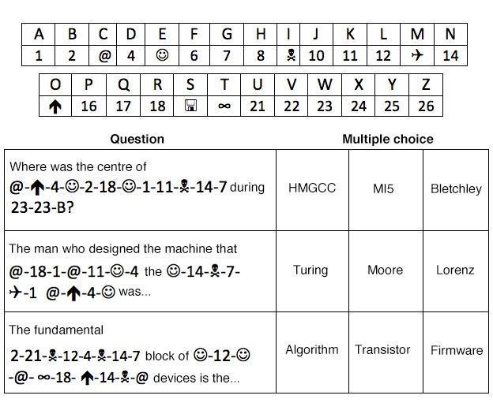
Practice
Notes:
1. Where was the centre of CODEBREAKING in WW2?
Answer: Bletchley.
2. The man who designed the machine that CRACKED the ENIGMA CODE was...?
Answer: Turing.
3. The fundamental BUILDING block of ELECTRONIC devices is the...?
Answer: Transistor.

Slide 16
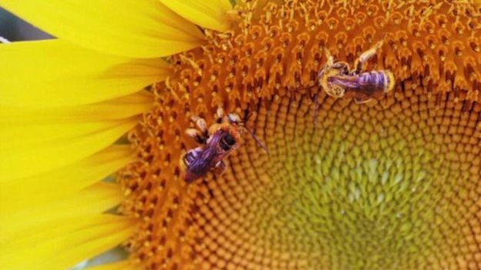
Practice (cont.)
This time there is no key to help decipher this short string of numbers, so it is a bit harder. However, here is a hint - once deciphered the string will reveal the name of a famous maths code that uses numbers.
5 8 1 14 13 0 2 2 8 18 4 16 20 4 13 2 4
There is a clue to the answer for Challenge Two in this photograph.
Notes:
Each letter was given a number starting with A=0, B=1, C=2 etc.
Applying that to the short sequence of numbers reveals the answer to be: Fibonacci Sequence.

Slide 17
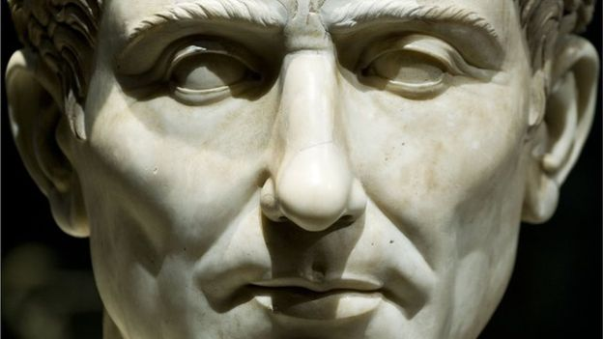
Practice (cont.)
Code-breaking was practised in Roman times: Julius Caesar was known to use a code to securely send messages to his armies. This message uses a type of cipher named after the general to conceal its meaning. When you crack it you will find out where he kept his armies.
Rm efp pibbsbp
It's no joke that Caesar used ciphers to conceal messages to his troops
Notes:
In the scheme we used, letters were moved three places to the right. The alphabet wraps round, so A=X, B=Y, C=Z and so on.
This gives the answer: Up his sleevies.

Slide 18
Practice (cont.)
Our officers have obtained an encrypted message. The forensics team was able to find a file that contains the string, "private" which was used to encrypt the message. Take it from here and obtain the plaintext message.
Wrkfs4Iyej
P R I V A T E P R
Notes:
Hacks4Pups

Slide 19
Practice
E c f o A m h m f q
YOWAIMO
Kbf prv gcfdi zj lfbp
RUBBER

Slide 20
Questions?

